Slide 1
Optimism
CELEBRATIONS

Slide 2
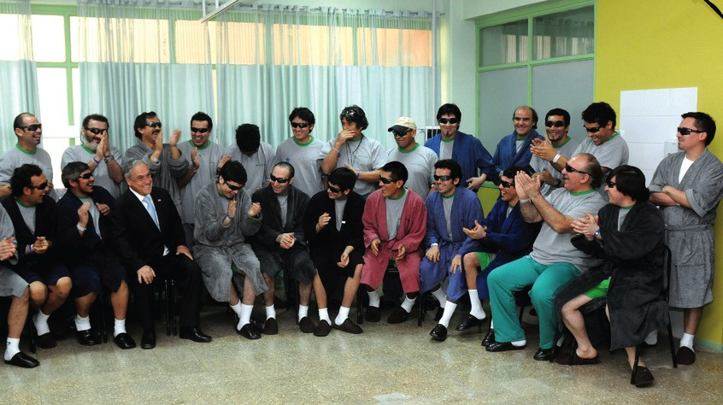
Rockfall
Notes:
Suddenly they were unable to see. Thick dust not only blocked the artificial light but irritated and burned their eyes for six hours. It was shortly after lunch when the routine of the day changed—and so has the story of history.
On August 5, 2010, a rockfall in the Chilean Copiapó copper mine trapped 33 miners 2,300 feet underground. Another group of miners that was nearer the entrance of the mine was able to escape, but for the 33 it was another story. Their world had collapsed around them.
Uppermost in their minds was the need to survive and escape. The shift leader, Luis Urzua, immediately took charge and organized the men into a team that made all their decisions on a democratic basis—the majority votes carried each action and plan.

Slide 3
Rockfall
Notes:
Ventilation problems forced the men to move out of their 540-square-foot (50-square-meter) emergency shelter into a tunnel. They had access to 1.2 miles (2 kilometers) of galleries in which to move around. Lack of emergency ladders hampered vain attempts to escape through ventilation shafts. Their two- to three-day emergency supplies were stretched to last two weeks. Careful rationing, strict discipline, social support, and camaraderie all came into play.
Each of the men lost an average of 18 pounds (8 kilograms) in weight. For some, this was an uncomfortable but needed advantage; otherwise they may not have fit into the escape capsules when ultimately found.
On August 22 a drill bored its eighth hole and broke into a shaft close to where the trapped miners were anxiously anticipating rescue. For days the miners had heard the drills and prepared notes to attach to the drill bit. The now famous paper was attached with the words: “We are well in the shelter, the 33.” Joy and excitement broke out both above and below ground level; however, there was uncertainty as to how the rescue would be executed and concern that it could take many months to complete.

Slide 4
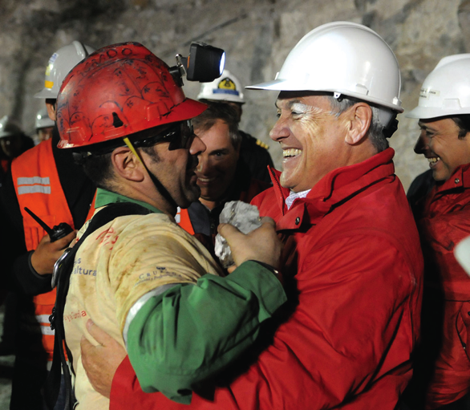
Camp Hope
Notes:
During this time another interesting phenomenon occurred: a tent city sprang up in the desert near the mine entrance. At first, family and friends slept in cars and waited and prayed. Friends then brought tents and other supplies to help those keeping vigil to survive the hostile desert environment. The settlement was appropriately named Campamento Esperanza (Camp Hope).
Multicultural collaboration, engineering ingenuity, careful planning, and dogged determination led to the miners emerging one by one, safe and alive, 69 days after being trapped. The date—October 13, 2010.

Slide 5
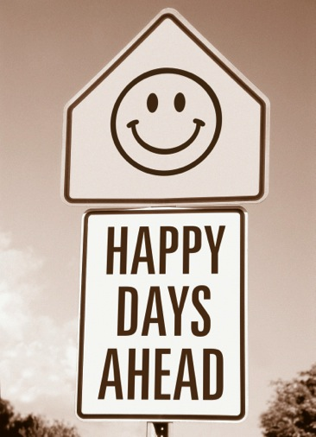
The impetus to keep going
Notes:
What kept the men going? Social support, leadership, collaboration, discipline, a sense of humor—all these played vital roles. Most important, however, were optimism and hope.
Those working above ground were based in Camp Hope. Those in the bowels of the earth emphasized hope, faith, and optimism in their communication with rescuers and families. The pope and other religious leaders prayed for them. One of the miners had the amazing experience of watching his wife give birth to their daughter through a visual communication setup during the rescue operation. The parents called her Hope, because they, along with the other miners and their families, never lost hope. The youngest miner, Jimmy Sanchez, shared his hopes and thoughts in a letter: “I want to eat so many things. I’m hungrier than ever. All these days I’ve been dreaming about my mom cooking for me. That will happen soon. After the bad comes the good.”¹
It was a frightening and harrowing experience for all concerned, but running throughout their amazing story are the threads of optimism and hope—indispensable ingredients of a full, healthy, and happy life.
Optimism and hope make all the difference.

Slide 6

Defining optimism
Notes:
What is optimism? There are many synonyms and related words: “happiness,” “hope,” “joyfulness,” “positive attitude,” “high spirits,” and “cheerfulness,” among others. Optimism has been defined as an enduring tendency to expect good personal outcomes in the future.² This fits with the Oxford dictionary definition, which describes optimism as an inclination to “hopefulness and confidence.”³ Hope and optimism will therefore be used interchangeably in this chapter.

Slide 7

Two looking out the same window see different things
Notes:
Two people looking out the same window may see different things. The optimist, for example, may see beautiful stars that brighten the night; the pessimist may see mud, which further depresses the mood. Through the eyes of an optimist the glass is seen as half full; through the eyes of the pessimist the glass is seen as half empty. Optimism is the face of our faith, and it is built on hope and trust in God, and belief that He can work things out for our best. This is based on the verses: “We know that in all things God works for the good of those who love him” (Rom. 8:28, NIV) and “God is faithful; he will not let you be tempted beyond what you can bear. But when you are tempted, he will also provide a way out so that you can endure it”
(1 Cor. 10:13, NIV).

Slide 8

Choose optimism
Notes:
The optimist may have peace and even joy when things do not turn out the way he or she had wanted. In this life we experience brokenness, sickness, and even death; yet through all this, we may know an equanimity and peace that are beyond human understanding or expectation. By exercising the choice to be optimistic, we can enjoy wholeness even in our human brokenness. (And we all are broken in some way or another, be it physically, mentally, emotionally, or spiritually.)

Slide 9
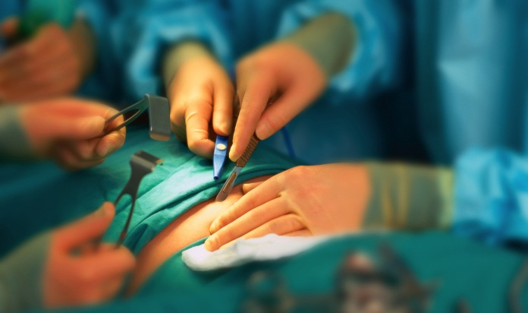
Hope without healing?
Notes:
She was in her late 30s and a mother of three. Her diagnosis was that of melanoma (malignancy of the skin), which had now spread throughout her body despite treatment to keep the tumor under control. She had been through much in her quest for a cure, including participation in two clinical trials. The tumor had shown a mild response to one of the treatments, but at the cost of many hospitalizations, severe fatigue, a punctured lung, and severe infections. When the cancer again was found to be out of control, she eagerly enrolled in a third clinical study. This was to be different from the previous experiences—this was an early phase trial, and any benefits would be for the research. She was unlikely to benefit herself. This particular study required major surgery prior to taking the experimental medication.
The evening before the operation when asked if she had additional questions, she smiled and stated that she didn’t and that having been through this before she knew what she was letting herself in for. Then in a lowered tone she added that she was a mother and would do anything to be able to have even just a little more time with her children. The attending staff members were in awe of her selfless courage. They were also impressed that her optimism, although based on false hopes in a hopeless situation, had to be of some benefit to a person in her position. She died one year later—the tumor did not respond to the experimental treatment.

Slide 10

Many in need choose to be optimistic
Notes:
This sad but inspirational experience confirms what we know so well—things don’t always turn out the way we would like them to. Many of us need help making the choice to be optimistic, particularly under difficult circumstances. Family and other social support is both helpful and essential in this process. Pessimists tend to believe that bad events will last a long time, and they often relinquish the idea that situations will improve. The approach of the optimist, on the other hand, is to view a negative event as a temporary setback and be spurred on to try harder. Sometimes the realistic approach, which takes challenges and problems into account, may be viewed as pessimism; at the same time, a realistic optimist nurtures hope and perseverance, choosing to believe and work toward the improvement of circumstances and situations. “A pessimist sees the difficulty in every opportunity,” Sir Winston Churchill said. “An optimist sees the opportunity in every difficulty.”

Slide 11
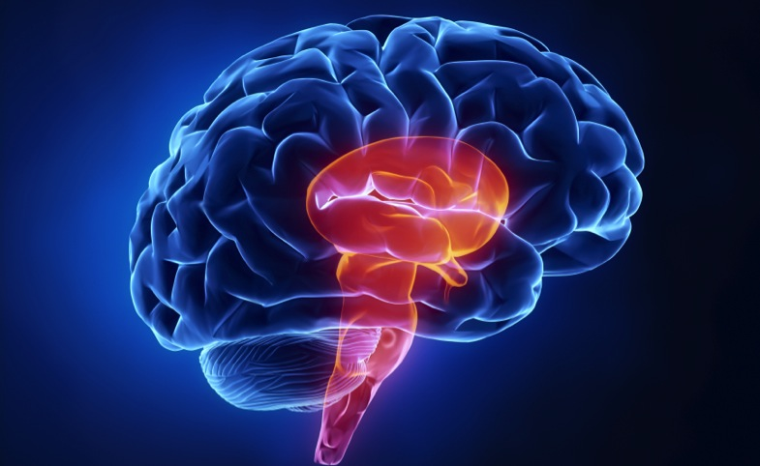
The brain is able to signal cheerful thoughts
Notes:
A substantial amount of research demonstrates that hope and optimism are associated with better mental and physical health. Additionally, people with higher levels of optimism have more effective coping mechanisms.⁴ In 2007 New Scientist published a fascinating article describing the demonstration of an area deep in the middle of the brain that is thought to be important in signaling and generating cheerful thoughts. Dr. Phelps and colleagues conducted these groundbreaking studies using magnetic resonance imaging (MRI), which may help us to better understand states of cheerfulness and depression even on an anatomical basis.⁵

Slide 12

Laughter is good medicine
Notes:
In the late 1970s Norman Cousins authored a book entitled “Anatomy of an Illness.”⁶ In it he describes his own experience with a debilitating illness and how, when medications failed to alleviate his pain and discomfort, he decided to watch humorous movies that elicited spontaneous and genuine laughter. To his delight and surprise he enjoyed physical and emotional improvement and ultimately returned to normal functioning.
Since that time much research has focused on the positive effects of genuine, relaxing laughter showing significant benefits to health, including an increased pain tolerance.⁷ Laughter triggers an uptake of endorphins, one of the brain chemicals responsible for the feeling of well-being as well as reducing pain.

Slide 13
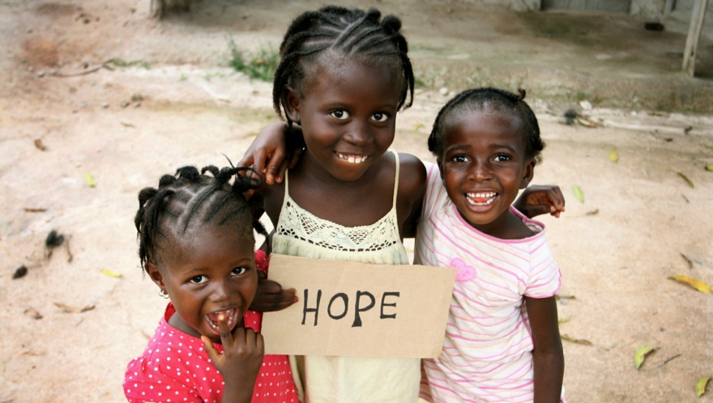
“A cheerful heart is good medicine”
Notes:
We are fearfully and wonderfully made! No wonder the Bible says: “A cheerful heart is good medicine, but a crushed spirit dries the bones” (Prov. 17:22, NIV).
So what may hearty laughter do for our bodies? It can:
exercise the lungs.
stimulate the circulatory system.
increase the oxygen intake into the lungs, which is then distributed by the blood to the cells.
act as an internal jogger: The heart rate, breathing, and circulation will speed up after good and hearty laughter.
Subsequently, the pulse rate and blood pressure will decrease, and the skeletal muscles may then become relaxed.

Slide 14

Laughter produces endorphins
Notes:
Studies show that each time a person is happy and has laughed genuinely (not forced, superficial laughter), the sympathetic nervous system is stimulated, which in turn produces catecholamines. These catecholamines then stimulate the anterior lobe of the pituitary gland to produce endorphins, which:
are the body’s natural opiates that soothe and relax the mind. They can relieve pain more effectively than morphine.
elevate the mood.
may increase the activity of the immune cells.
Laughter is surely a powerful medicine.

Slide 15
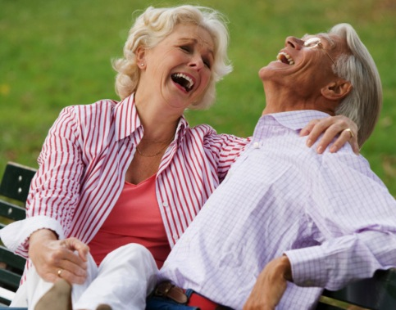
A positive attitude can be cultivated
Notes:
The twentieth-century lifestyle studies by Drs. Belloc and Breslow from the Department of Public Health, Berkeley, California, reinforce that longevity has a close connection with the happy disposition of people. This study involved 6,928 adult residents of Alameda County, and the results showed that those who were generally unhappy had a death rate 57 percent higher than those who were generally very happy.⁸ It’s not always possible to be happy and laughing, but a positive attitude can be cultivated—and studies show that a positive, optimistic attitude carries beneficial effects.
We can be happy and experience genuine laughter, especially when we completely trust God, knowing that He is in control of our lives no matter what the circumstances may be.

Slide 16

Positive thoughts
Notes:
Another interesting study was conducted by Dr. David McClelland, who showed a group of students a photograph of a couple sitting on a bench by a river. He requested that each student write a story about this couple to gain greater insight into each student’s subconscious perceptions and projections. He found that those who wrote stories depicting the positive outlook they had of this couple, envisioning them as enjoying a happy, trusting relationship, helping each other, respecting each other, and sharing warm, loving feelings with each other, demonstrated higher levels of immune antibodies and also reported fewer infectious diseases during the preceding year. Those who wrote stories depicting a negative outlook of the couple, in which they were seen to be manipulating, deceiving, or abandoning each other, demonstrated lower levels of immune antibodies and reported experiencing significantly more illness during the previous year. ⁹
Nurturing positive thoughts and emotions about people and situations impacts our own personal well-being. It’s also essential to note that our lives are not lived in a vacuum—we are social creatures. Social support and connectedness also strongly influence our emotional, spiritual, mental, and physical health.¹°

Slide 17

Summing up optimism
Notes:
The positive effects of hope and optimism impact human life at all ages and in many settings. Optimism significantly influences mental and physical well-being by helping to promote a healthful lifestyle as well as coping and adaptive responses/behaviors with more robust coping and problem-solving skills. These benefits also help to prevent burnout in such demanding situations as chronic-disease caregiving. Looking after Alzheimer’s patients is one example of this.¹¹
There will be times when we may feel just like the Chilean miners after the rockfall—trapped, buried alive by the events and circumstances that befall us. But we are never alone. We may choose to be optimistic, especially as we recall the wonderful promises of Scripture such as Lamentations 3:21-23: “Yet this I call to mind and therefore I have hope: Because of the Lord’s great love we are not consumed, for His compassions never fail. They are new every morning; great is Your faithfulness” (NIV).

Slide 18
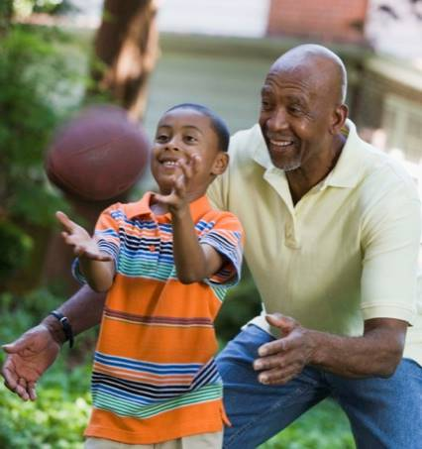
Hope and optimism impact life at all ages and settings.
Optimism promotes mental and physical well-being.
Notes:
Hope and optimism impact life at all ages and settings.
Optimism promotes mental and physical well-being.

Slide 19

Hope allows us to celebrate life and enjoy wholeness even in our brokenness
Optimism and hope are truly the joy in life.
Notes:
Hope allows us to celebrate life and enjoy wholeness even in our brokenness
Optimism and hope are truly the joy in life.

Slide 20

LIFE APPLICATION QUESTIONS
Notes:
LIFE APPLICATION QUESTIONS

Slide 21
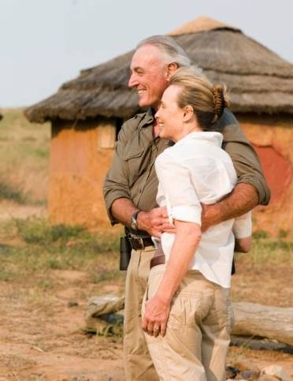
Stories abound of missionaries who faced incredible odds.
Their children died of malaria; they lived in very poor housing; they had to travel under difficult circumstances.
Notes:
Stories abound of missionaries who faced incredible odds. Their children died of malaria; they lived in very poor housing; they had to travel under difficult circumstances.

Slide 22
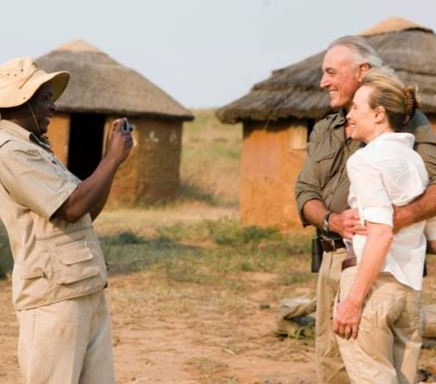
Some were often ridiculed; others saw very few results of their labors. Many were single with very few chances to meet with friends.
Notes:
Some were often ridiculed; others saw very few results of their labors. Many were single with very few chances to meet with friends.

Slide 23
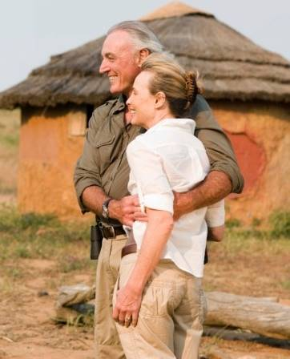
And all this while living thousands of miles from their homeland and families.
In spite of the hardships and sacrifices, however, they did it joyfully and willingly.
Notes:
And all this while living thousands of miles from their homeland and families. In spite of the hardships and sacrifices, however, they did it joyfully and willingly.

Slide 24
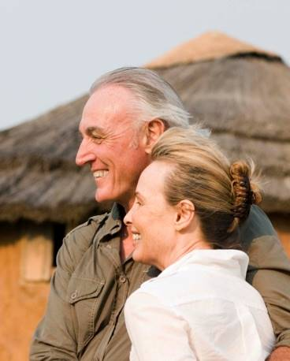
What gave them that optimism?
What choices do I have to make in order to be selfless and optimistic like that?
Notes:
What gave them that optimism? What choices do I have to make in order to be selfless and optimistic like that?

Slide 25
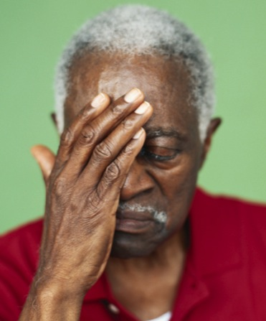
What devastating event have I experienced in my life that made me feel as if my world had caved in around me?
Did I choose to have hope in that situation?
Notes:
What devastating event have I experienced in my life that made me feel as if my world had caved in around me?
Did I choose to have hope in that situation?

Slide 26
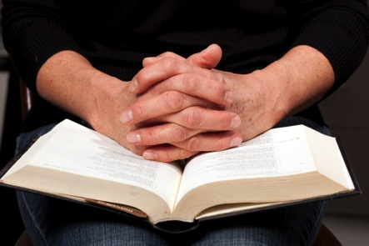
What, if anything, gave me that hope and assurance?
Notes:
What, if anything, gave me that hope and assurance?

Slide 27
If something like that happens again, what extra sources of hope can I tap into?
Which promises of Scripture will I choose to memorize?
Notes:
If something like that happens again, what extra sources of hope can I tap into? Which promises of Scripture will I choose to memorize?

Slide 28
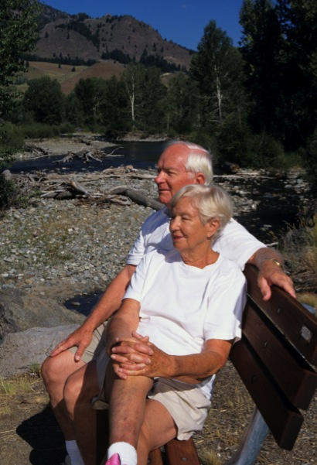
In most situations am I more likely to see the positive aspects or the negative ones?
Notes:
In most situations am I more likely to see the positive aspects or the negative ones?

Slide 29
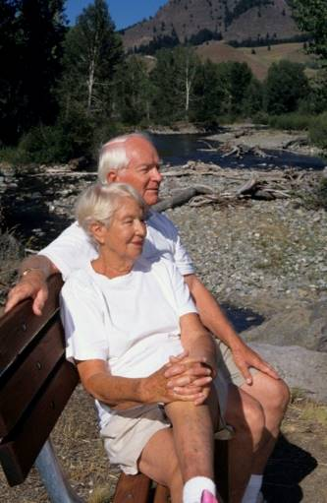
How can I change my perspective to become more optimistic, even while being realistic?
Notes:
How can I change my perspective to become more optimistic, even while being realistic?

Slide 30
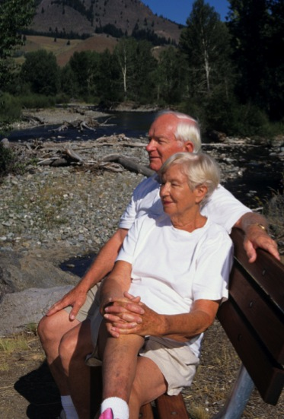
What can I do so that I look for opportunities rather than difficulties?
Notes:
What can I do so that I look for opportunities rather than difficulties?

Slide 31
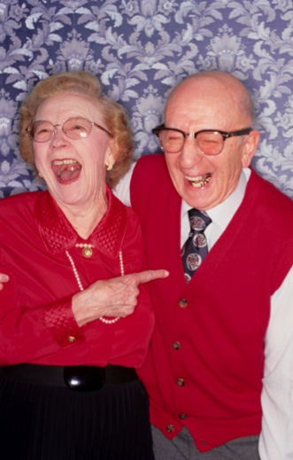
When was the last time I experienced genuine, relaxing laughter, so that my lungs got exercise and my whole body did a little internal jogging?
What triggered this event?
Notes:
When was the last time I experienced genuine, relaxing laughter, so that my lungs got exercise and my whole body did a little internal jogging? What triggered this event?

Slide 32
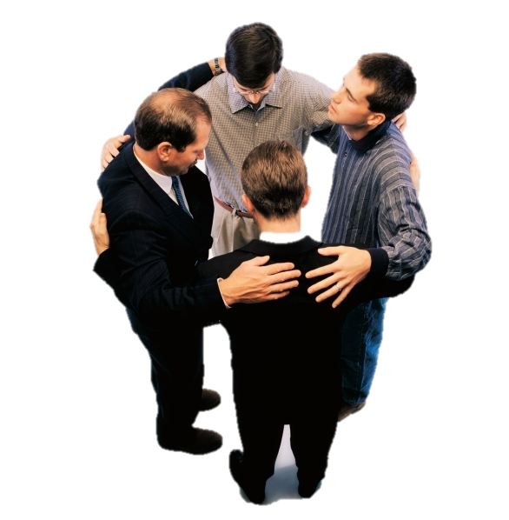
What choices will put me in this situation more often?
How do I make wise decisions in the choice of my friends, what I view on TV, what I read?
Notes:
What choices will put me in this situation more often? How do I make wise decisions in the choice of my friends, what I view on TV, what I read?

Slide 33
How can I adjust my view of God, so that I can be joyful without feeling guilty?
Notes:
How can I adjust my view of God, so that I can be joyful without feeling guilty?

Slide 34
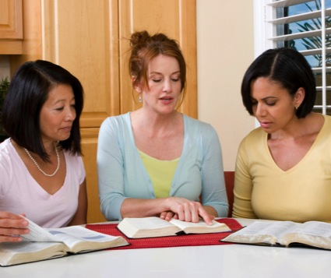
How can I nurture positive thoughts and emotions about people and situations?
How can I balance the bad news I hear with the good news of the gospel?
Notes:
How can I nurture positive thoughts and emotions about people and situations? How can I balance the bad news I hear with the good news of the gospel?

Slide 35

Do the stories I read or the movies I watch give me confidence that God is in control and working toward the salvation of the world and a better world to come?
Notes:
Do the stories I read or the movies I watch give me confidence that God is in control and working toward the salvation of the world and a better world to come?

